Slide 1
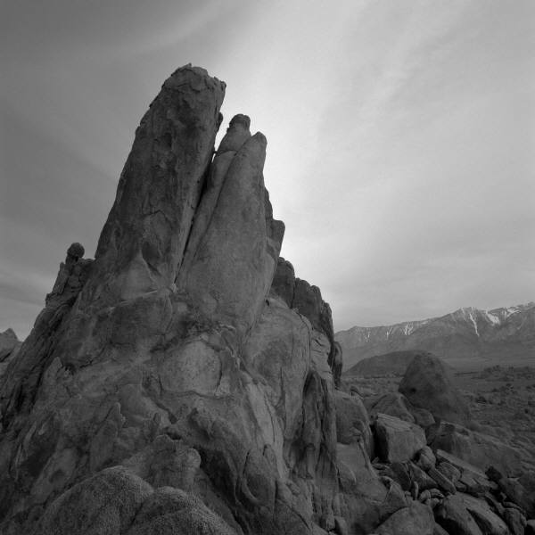
Big brother
A proprietary app to prevent violent extremism

Slide 2
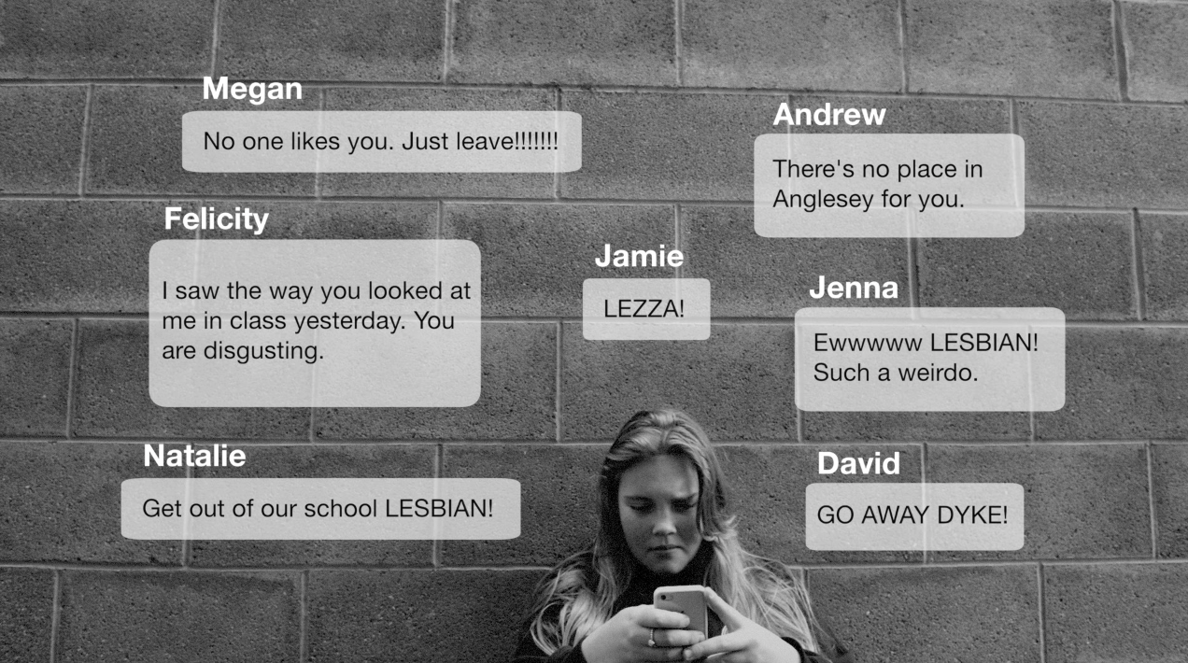
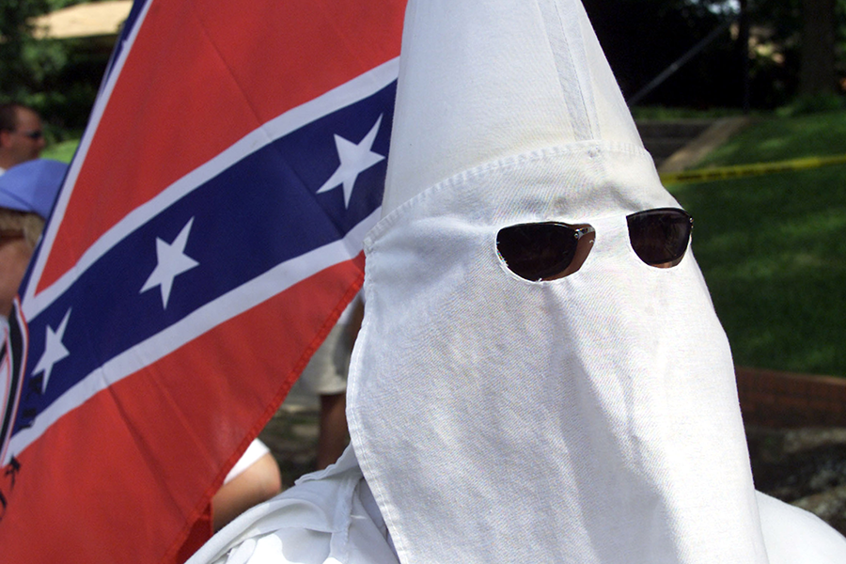
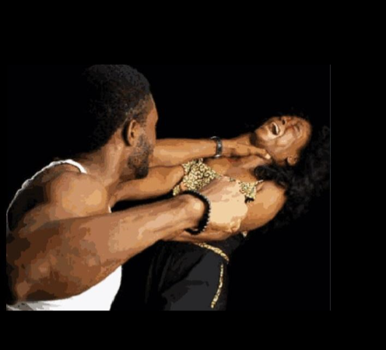
What is Violent Extremism
Beliefs and actions of people who support or use ideologically motivated violence to achieve radical ideological, religious or political views.

Slide 3
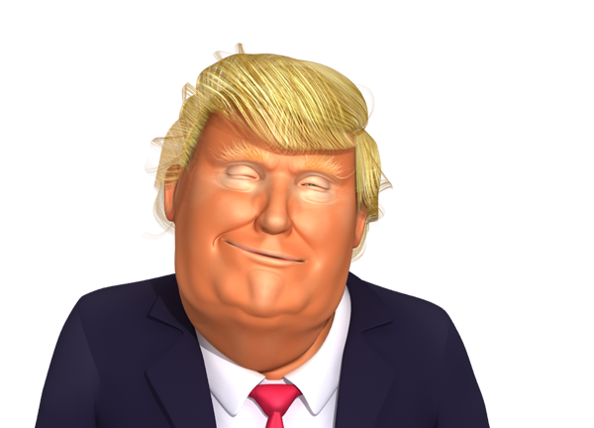
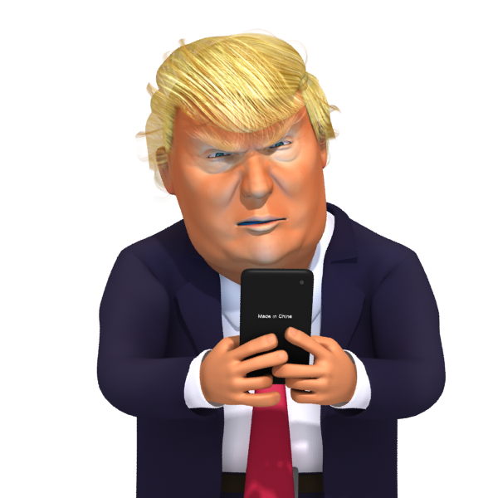
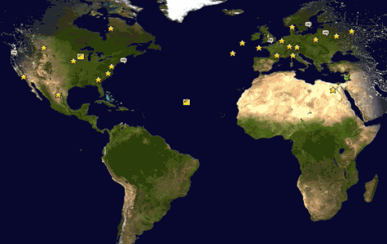
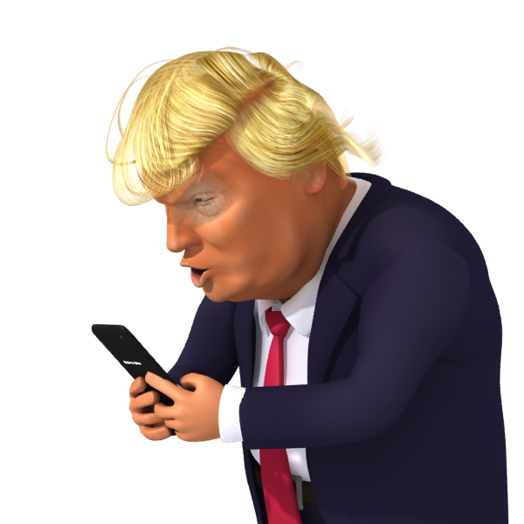


BigBrother
Vision: Prevent violent extremism
Mission: Create an intelligence system
Understand and identify targets of violent extremist content online
Engineer and push content through touch-points to subliminally avert conversion.
Ask us how
Example
Mr. Dwumph
8 AM 10 AM 12 PM 3 PM 5PM 10 PM 12 AM

Slide 4
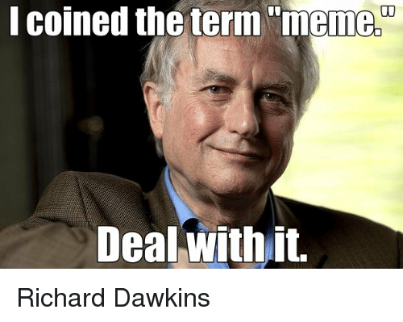
Memetic Engineering
Information is selfish and wants to infect as many minds as possible.
But, not all kinds of information can survive this race to occupy space in brains – Survival of the fittest

Slide 5

This photo album contains sample pages to get you started.
To add your own pages, click the Home tab, and then click New Slide.

Slide 6

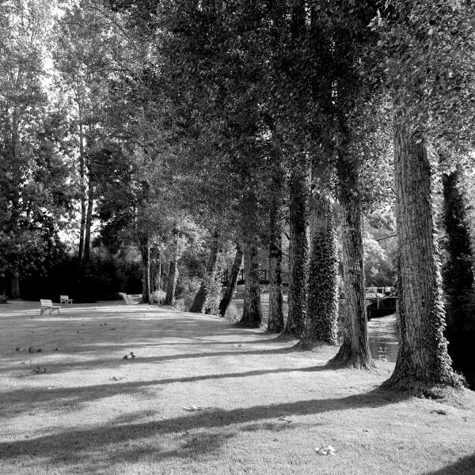
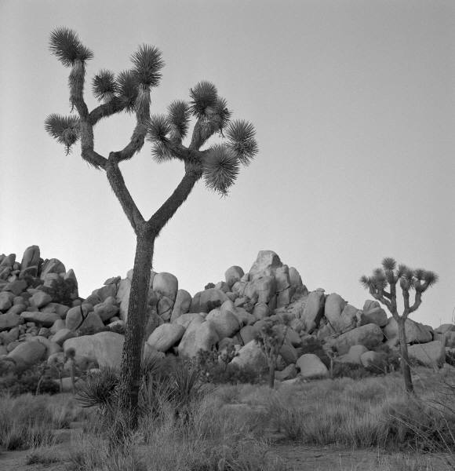
Choose a Layout
…then click the placeholders to add your own pictures and captions.

Slide 7
Click a picture, and then click the Format Picture tab to create your own frames and make picture corrections such as adjusting contrast and brightness or cropping the picture for just the right look.

Slide 8
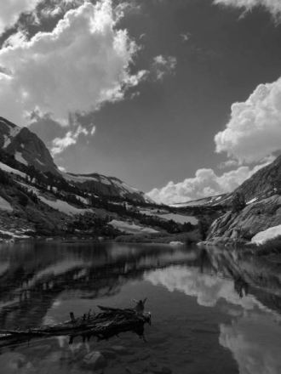
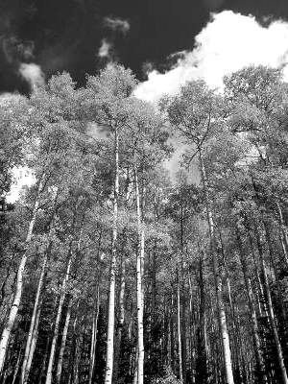
Picture Styles give you great looking “frames” in a single click.

Slide 9


Slide 10


